Slide 1

TRAFFIC VOLUME MULTICLASS CLASSIFICATION AND REGRESSION
Professor: Dr. Krishna Bathula

Slide 2
PROBLEM STATEMENT
Multiclass Classification: Classify traffic volume during peak hours into three categories:
Low Traffic
Medium Traffic
High Traffic
Regression: Predict the continuous value of traffic volume counts directly based on features such as:
Date and time
Other traffic-related factors

Slide 3
DATASET OVERVIEW
Dataset Name: NYC Traffic Volume Counts
Source: City of New York Open Data
Link: NYC Traffic Volume Counts Dataset
Features Available:
Date and Time
Traffic Volume
Location (Street, Cross Street, Borough)
Use in Project:
Classify traffic level (multiclass classification)
Predict traffic volume (regression)

Slide 4
MACHINE LEARNING MODELS
DECISION TREE
RANDOM FOREST
By : RAGHAVI SENDIL

Slide 5
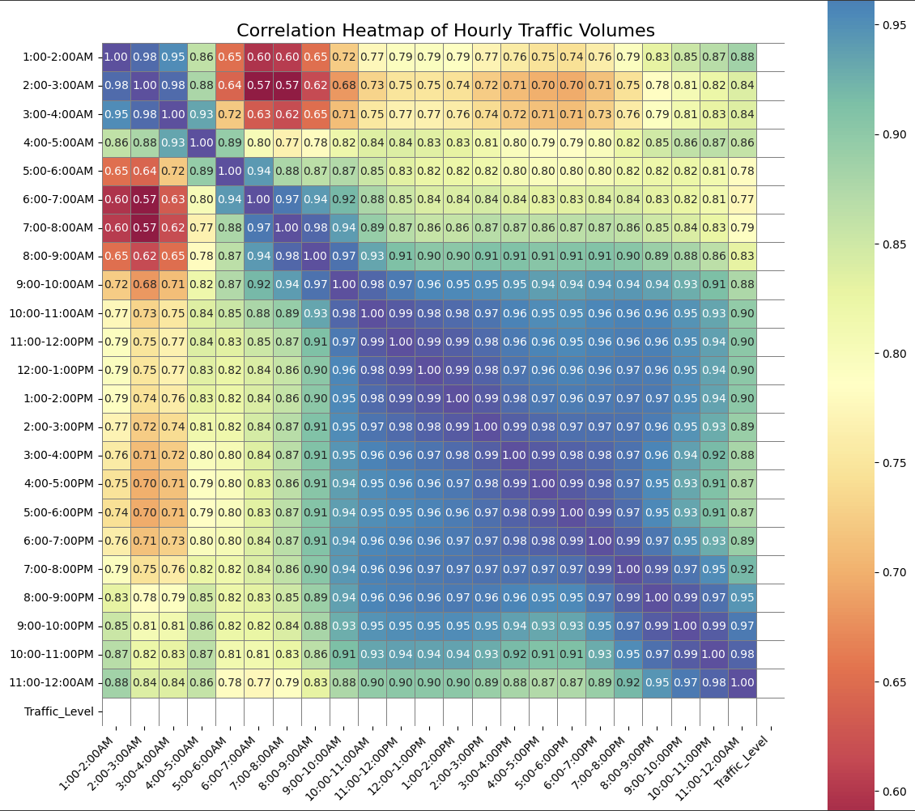
Exploratory Data Analysis (EDA):
We analyzed missing values.
We visualized feature correlation with a heatmap.
We found strong correlations among peak traffic hours.
We detected class imbalance: Majority of samples were High Traffic.

Slide 6
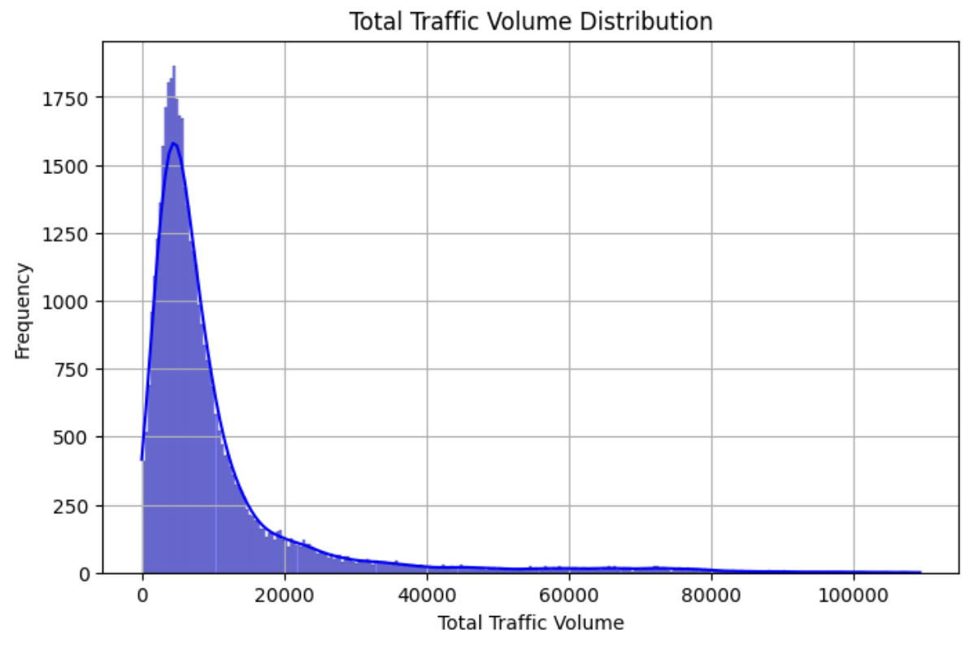
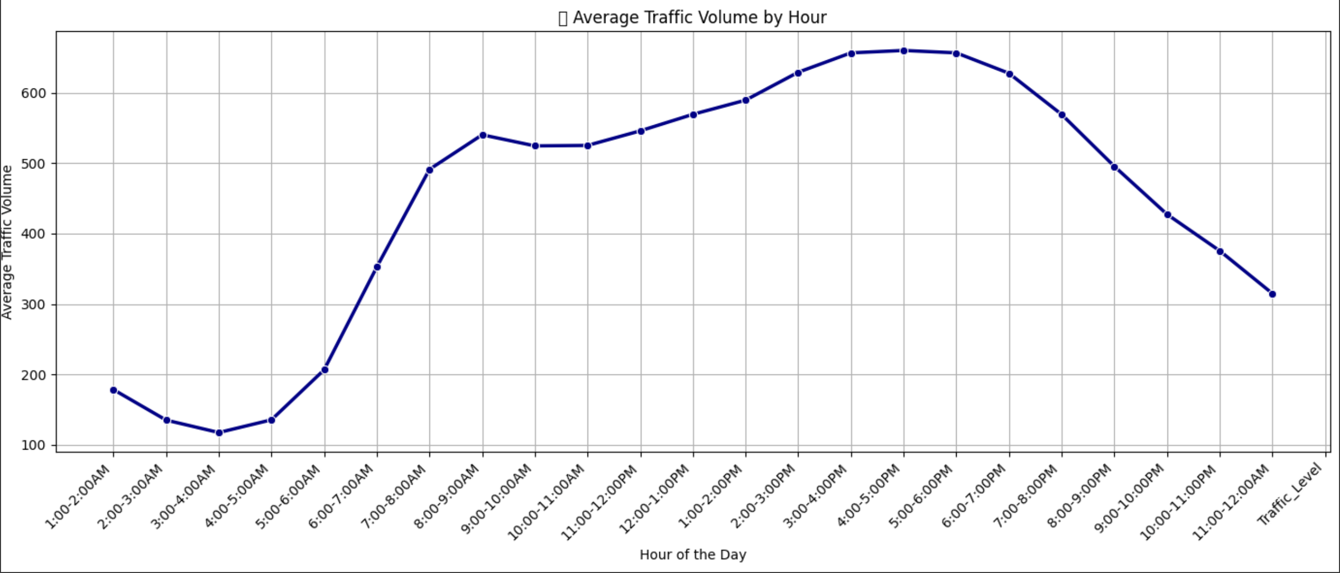
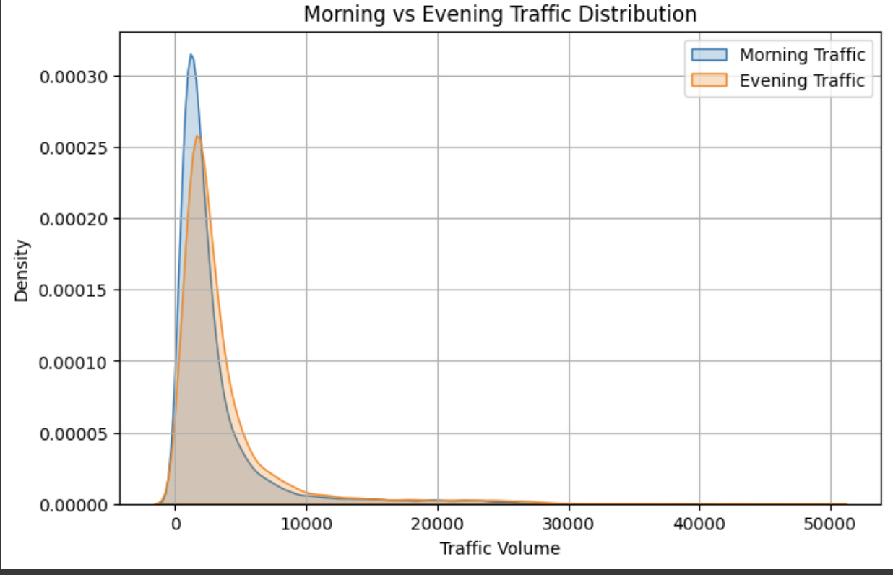
FEATURE ENGINEERING:
Created Total_Traffic: Sum of all hourly traffic volumes.
Created Morning_Traffic: Sum from 6:00 AM to 12:00 PM.
Created Evening_Traffic: Sum from 4:00 PM to 10:00 PM.

Slide 7
GINI IMPURITY and INFORMATION GAIN
Gini Impurity measures how "pure" a node is.
How often would a randomly chosen element be incorrectly labeled?
Gini = 0 → Perfectly pure (all data points belong to the same class).
Higher Gini → More mixed classes at the node (bad split).
Information Gain measures the reduction in uncertainty (entropy) after a split.
High Entropy = Highly unpredictable
Low Entropy = Highly ordered
Measures how much uncertainty decreases after a split. Higher is better.
Trees split based on Gini or Information Gain to build the best structure.

Slide 8
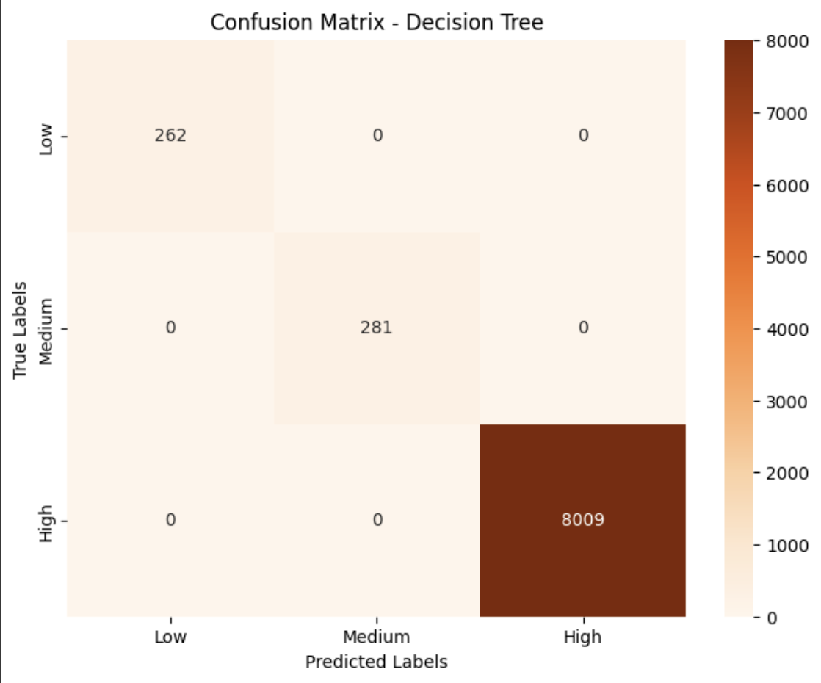
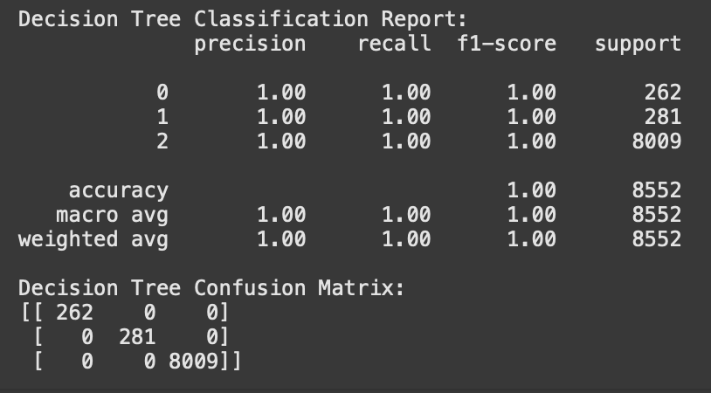
MODEL TRAINING for DECISION TREE
Precision - How many predicted labels were correct.
Recall How many true labels were captured correctly.
F1-Score Balance between Precision and Recall.
Support Number of real samples in each class.

Slide 9
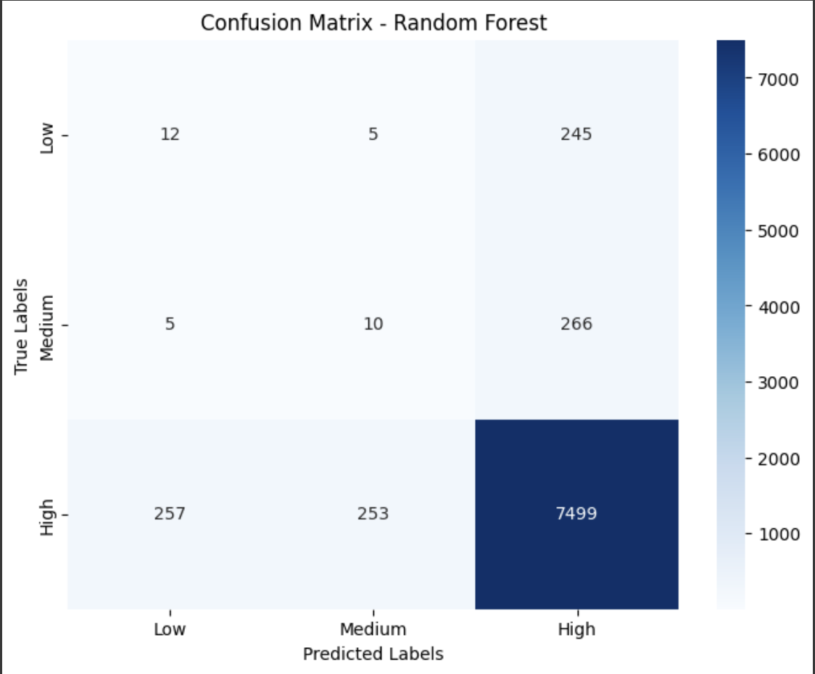
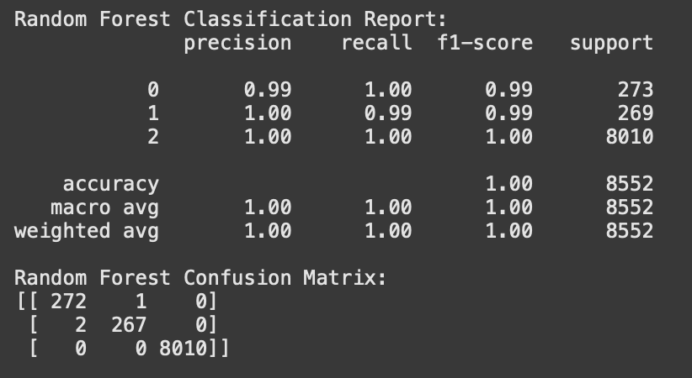
MODEL TRAINING for RANDOM FOREST
Precision - How many predicted labels were correct.
Recall How many true labels were captured correctly.
F1-Score Balance between Precision and Recall.
Support Number of real samples in each class.

Slide 10
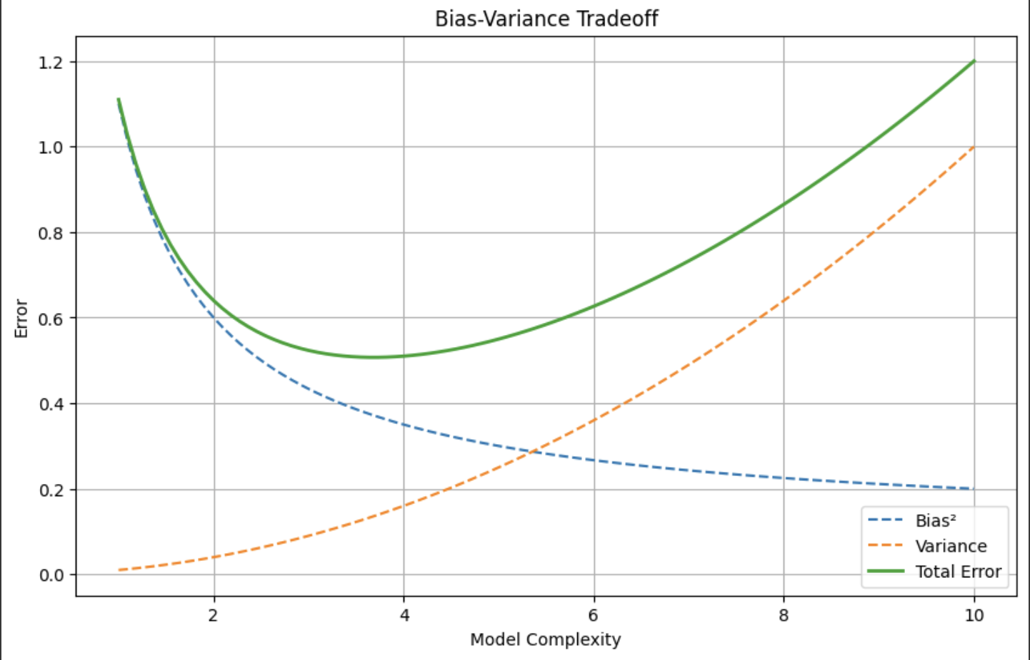
BIAS- VARIANCE TRADEOFF
Bias: Error due to overly simple assumptions in the model (underfitting). ➔ Example: A model too simple to capture traffic patterns.
Variance: Error due to the model being too complex and sensitive to training data (overfitting). ➔ Example: A model perfectly memorizing training data but failing on new data.
Tradeoff:
A model must balance bias and variance to achieve good generalization.
Too much bias → Underfitting.
Too much variance → Overfitting.
Decision Trees typically have low bias but high variance, leading to overfitting. Random Forests, by averaging multiple Decision Trees, reduce variance and help achieve a better bias-variance tradeoff..

Slide 11
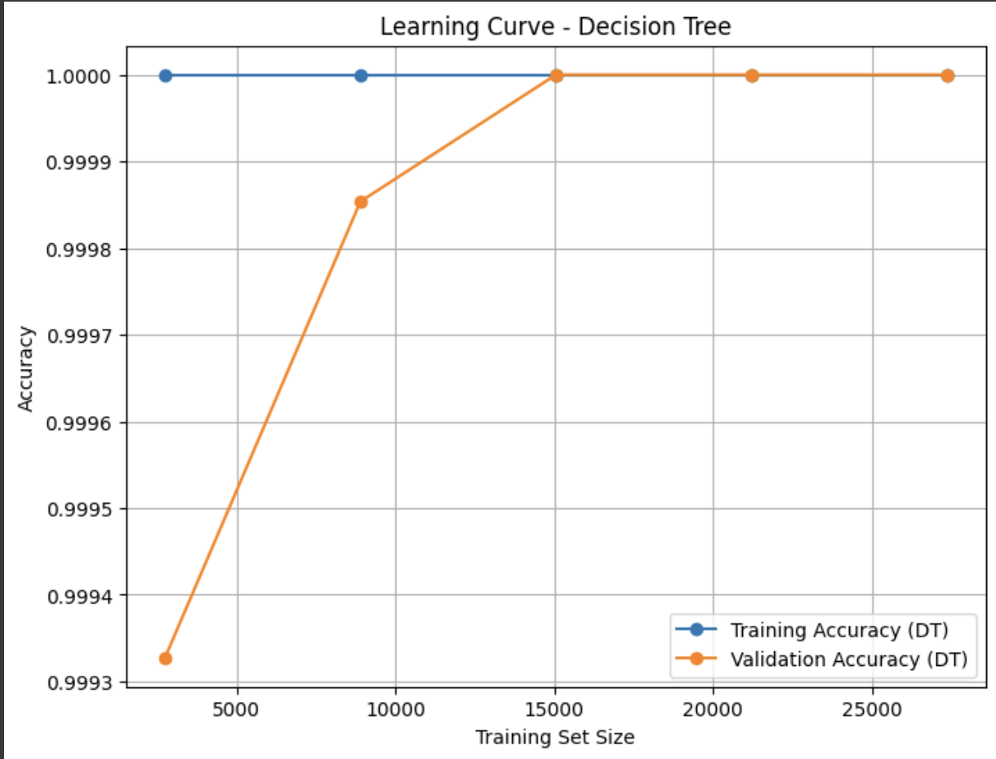
LEARNING CURVE - DECISION TREE
Decision Tree: Training accuracy = 100%, but potential overfitting risk.

Slide 12
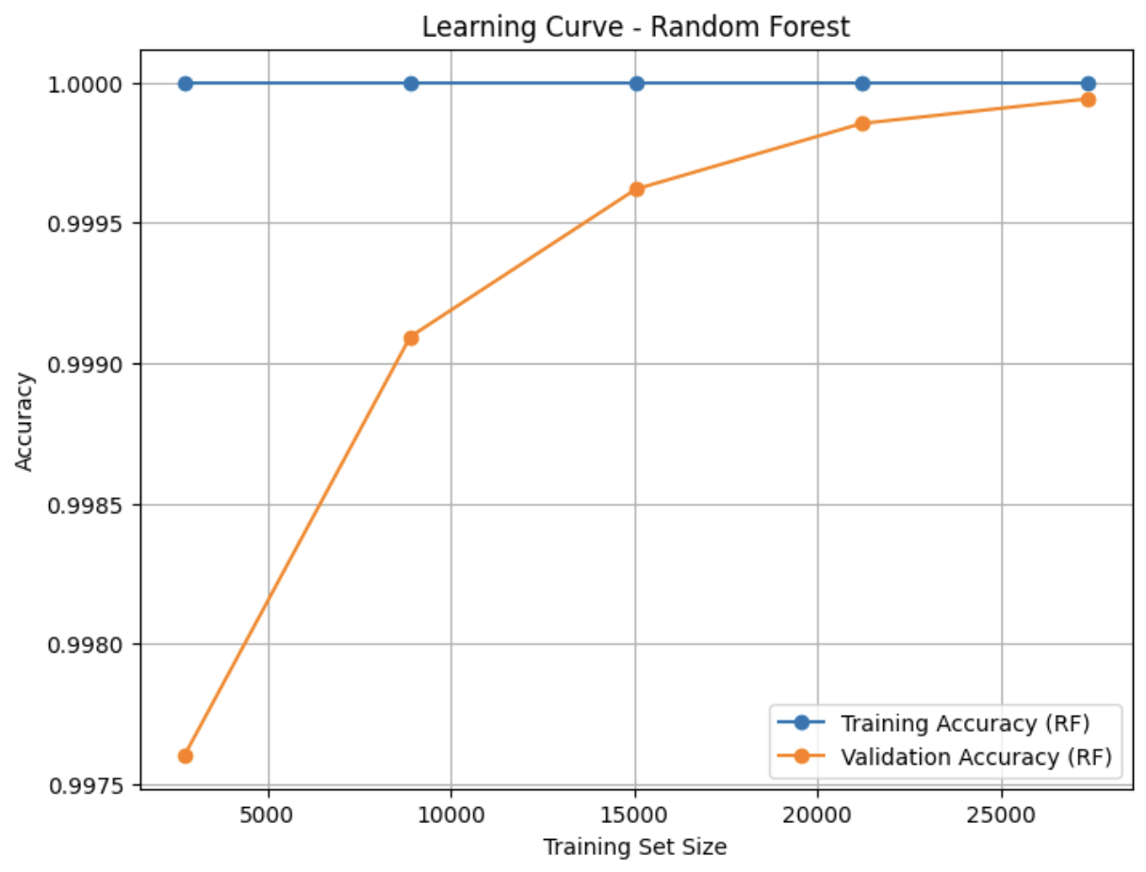
LEARNING CURVE – RANDOM FOREST
Random Forest: Smaller gap between training and validation accuracy → better generalization.

Slide 13
CONCLUSION
Decision Tree - 100% perfect classification on test set . Model overfitting.
Random Forest - High precision for High Traffic but confusion between Low/Medium classes.

Slide 14
REGRESSION
JAYASHREE JOHNSON

Slide 15
PREDICTING TRAFFIC VOLUME USING MACHINE LEARNING MODELS
Predict the continuous value of total traffic volume based on hourly traffic counts and location features.
Use supervised regression models (Linear Regression, Decision Tree, KNN, SGD Regressor, SVR) to model the relationships.
Help support automated traffic planning and congestion management by accurately forecasting total volume.

Slide 16
REGRESSION OVERVIEW
Data Preprocessing:
Handle missing values, standardize features, engineer total volume.
Model Development:
Train Linear Regression, Decision Tree, KNN, SGD, and SVR models.
Hyperparameter Tuning:
Tuned max_depth, min_samples_leaf, n_neighbors, and weights using GridSearchCV.
Adjusted max_iter for SGD Regressor.
Model Evaluation & Comparison:
Evaluated using RMSE, MAE, MSE, R².
Compared models and selected the best performer.

Slide 17
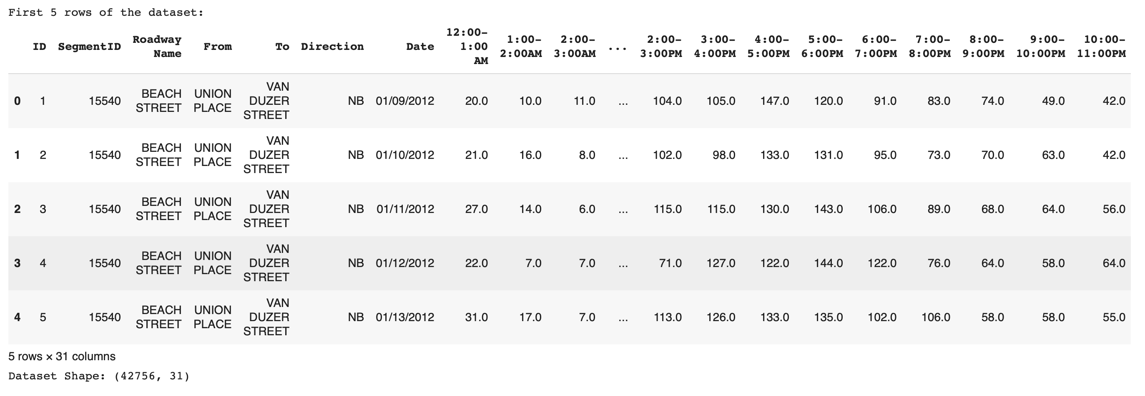
EXPLORATORY DATA ANALYSIS (EDA)

Slide 18
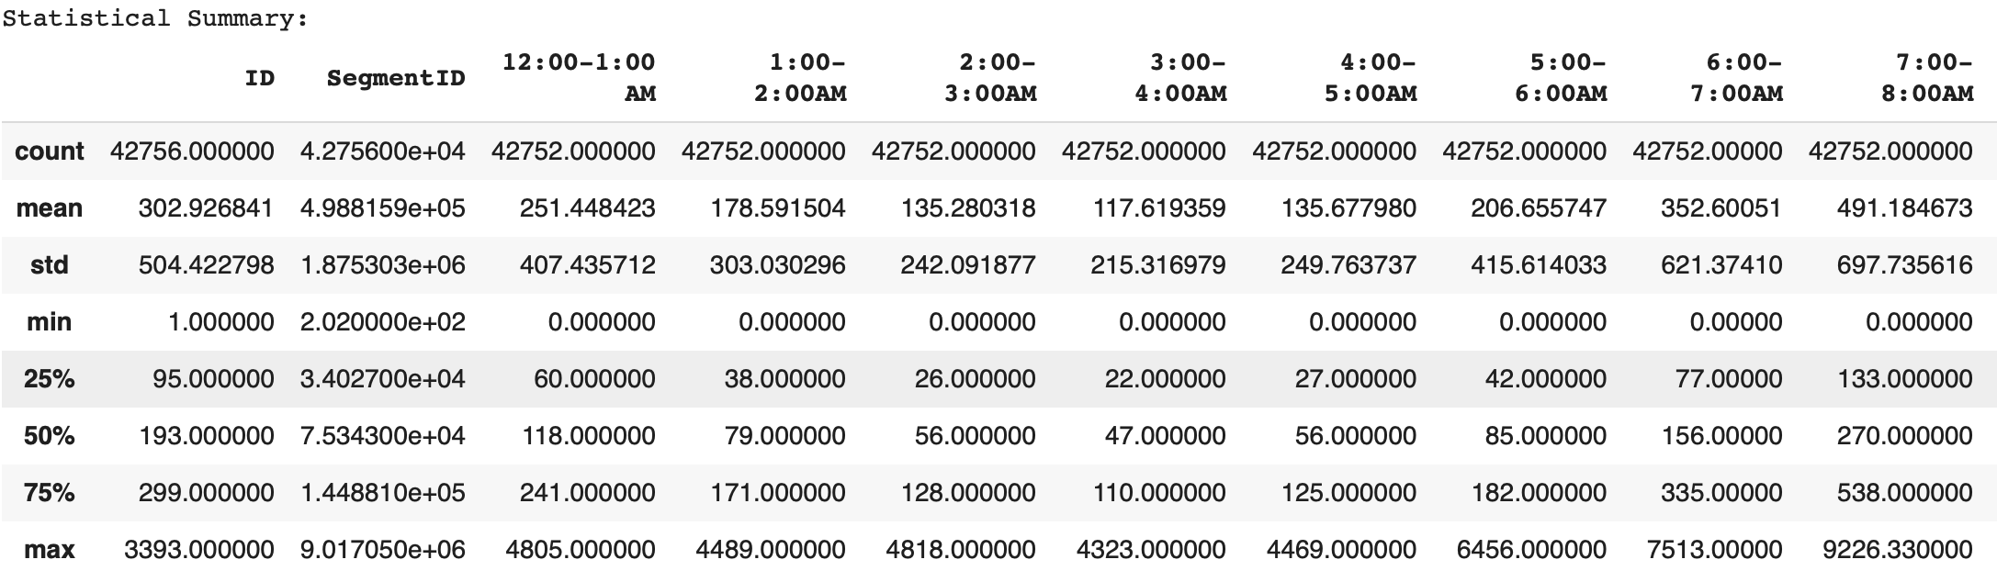
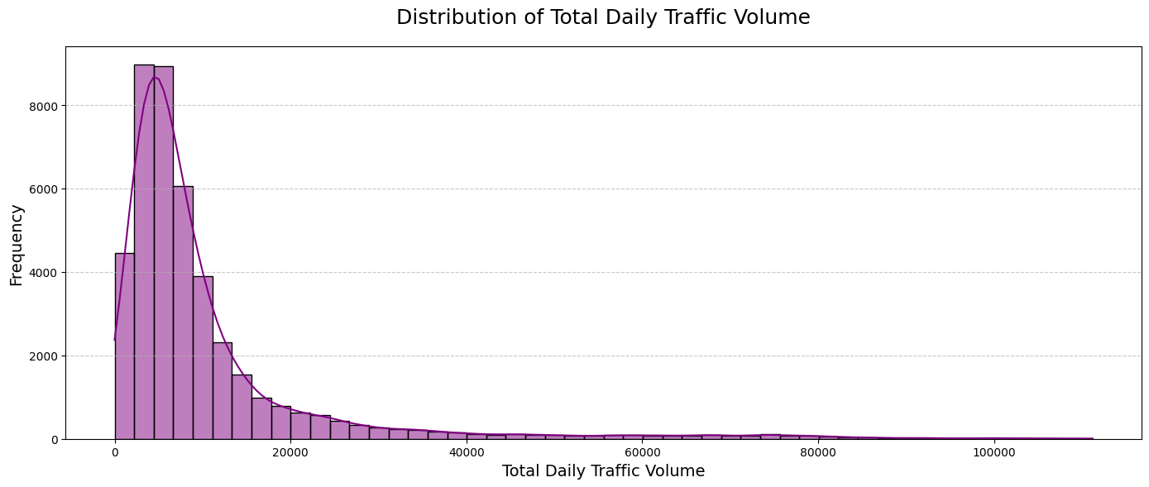
EXPLORATORY DATA ANALYSIS (EDA)

Slide 19
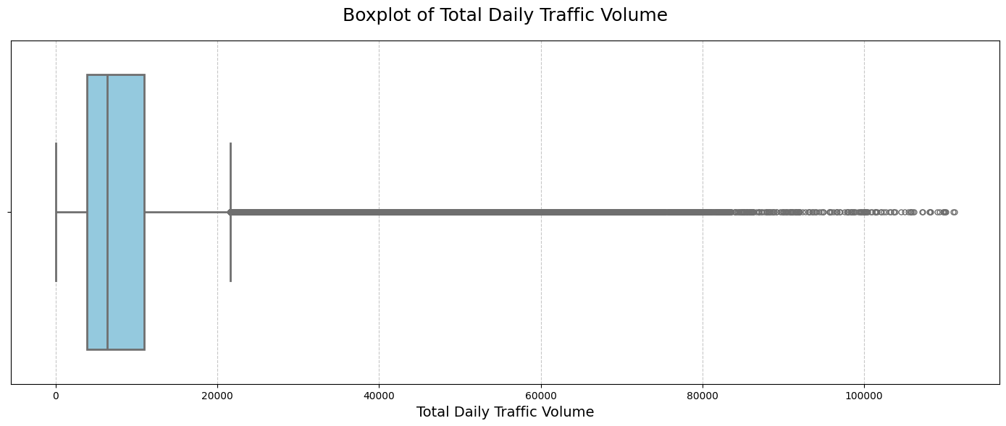
EXPLORATORY DATA ANALYSIS (EDA)
Reviewed dataset structure (head(), info()).
Summarized key statistics (describe()).
Identified missing values in hourly traffic counts.
Observed right-skewed traffic volume distribution.
Detected outliers during peak traffic hours

Slide 20
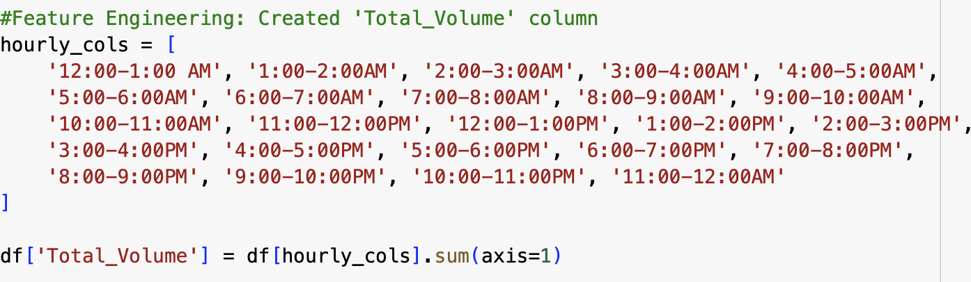
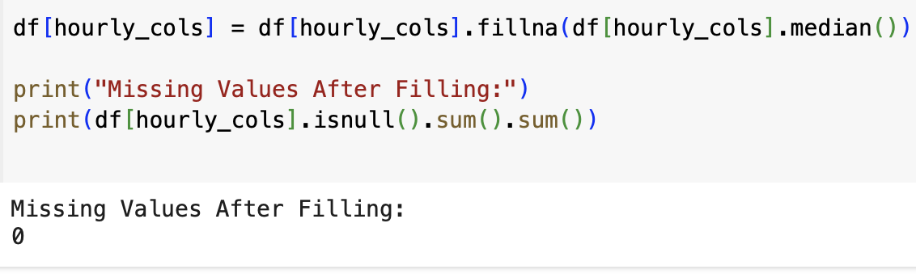
DATA PREP & FEATURE ENGINEERING
Handled missing values with median imputation and standardized features using StandardScaler.
Engineered the "Total Volume" target by summing hourly traffic counts; no additional feature extraction was necessary.

Slide 21
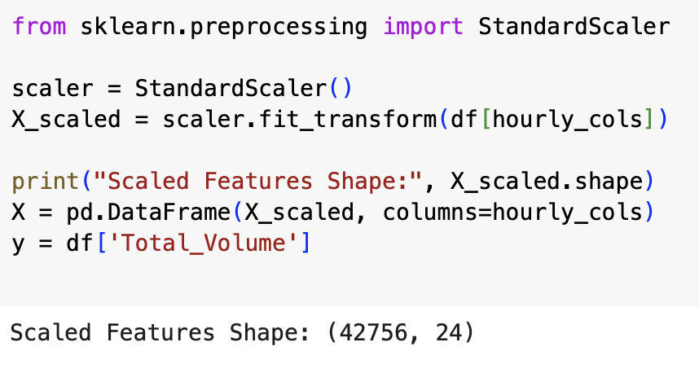
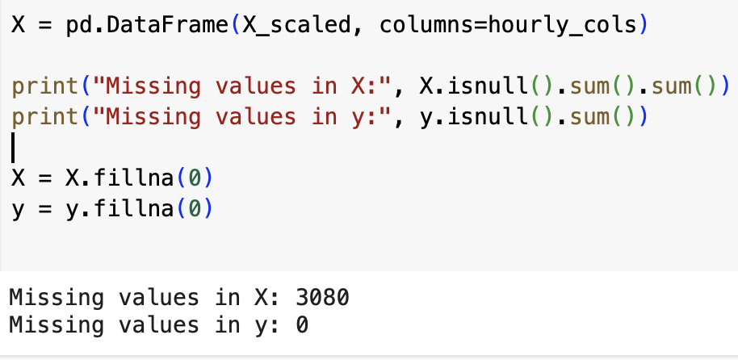
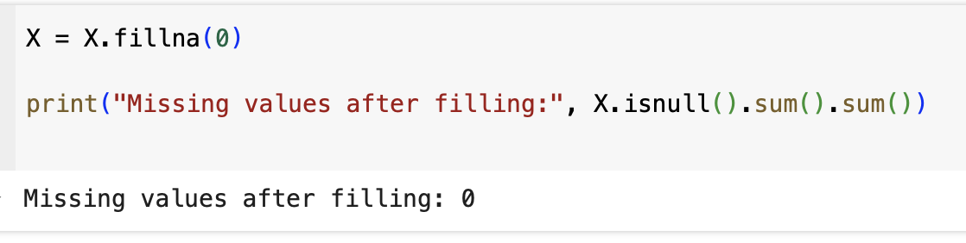
DATA PREP & FEATURE ENGINEERING

Slide 22
MODEL BUILDING
Train-Test Split:
80% training, 20% testing split.
Models Developed:
Linear Regression
Decision Tree Regressor
K-Nearest Neighbors (KNN) Regressor
Stochastic Gradient Descent (SGD) Regressor
Support Vector Regressor (SVR)
Cross-Validation:
Applied 5-Fold Cross-Validation for robust evaluation.

Slide 23
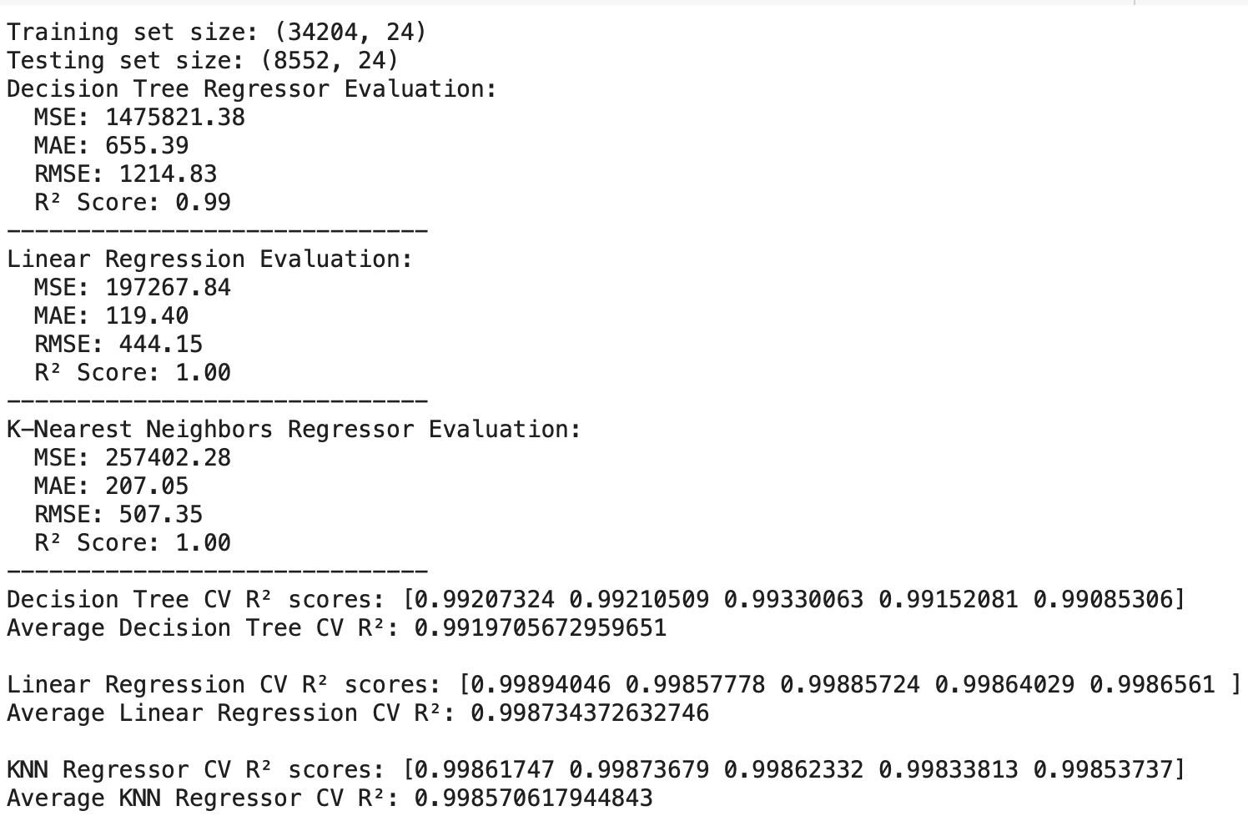
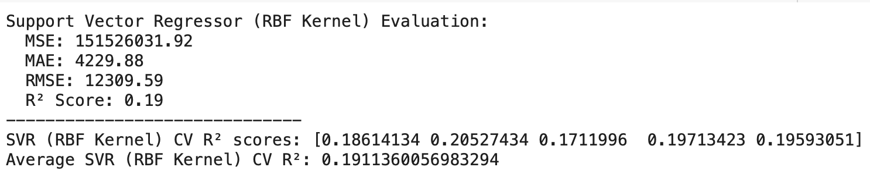
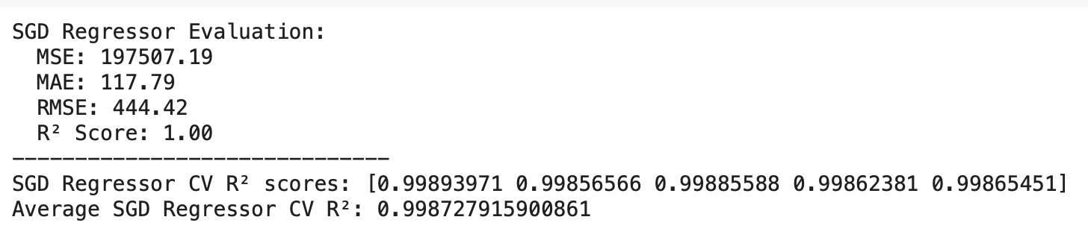
MODEL BUILDING
MODEL INITIAL EVALUATION

Slide 24
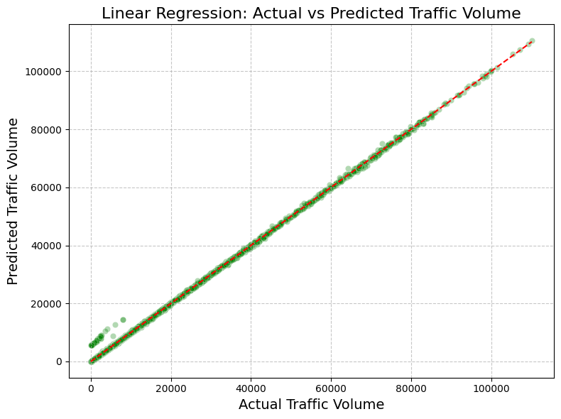
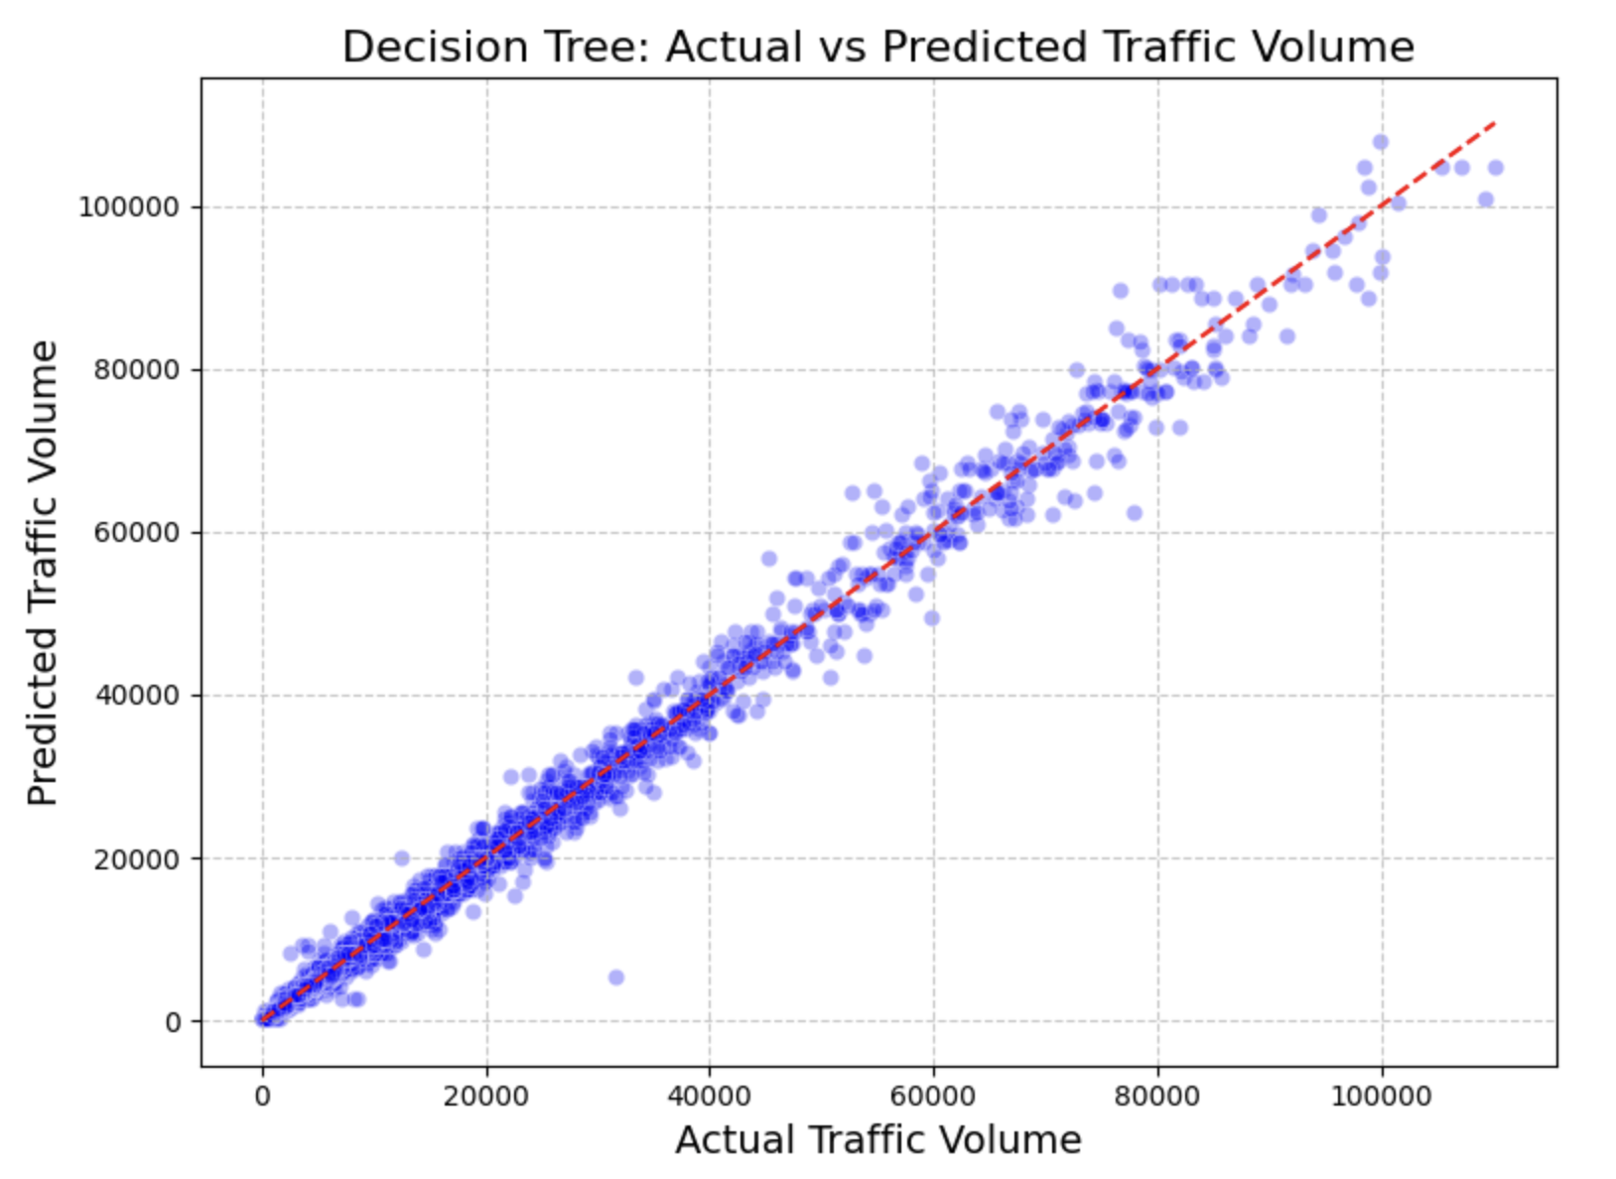
MODEL INITIAL EVALUATION

Slide 25
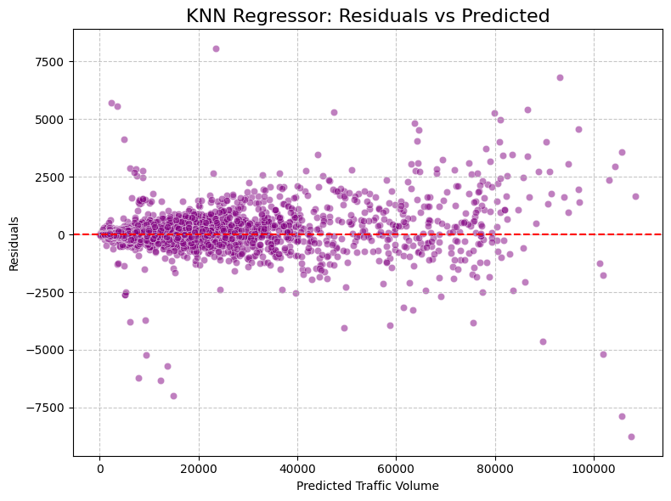
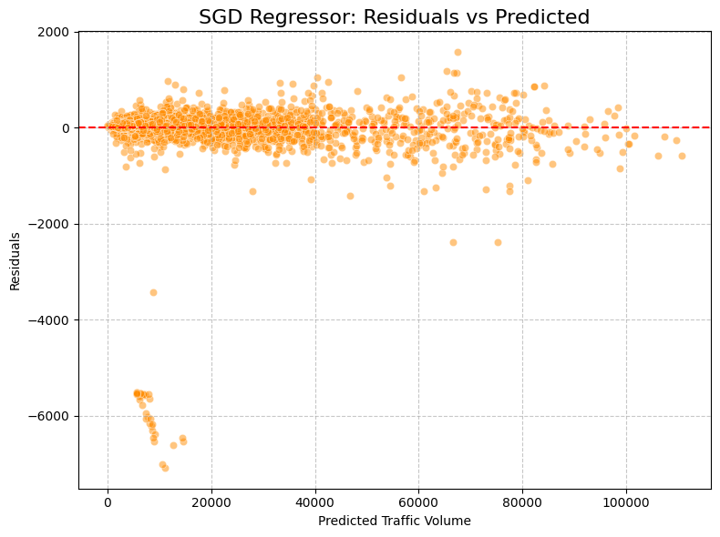
MODEL INITIAL EVALUATION

Slide 26
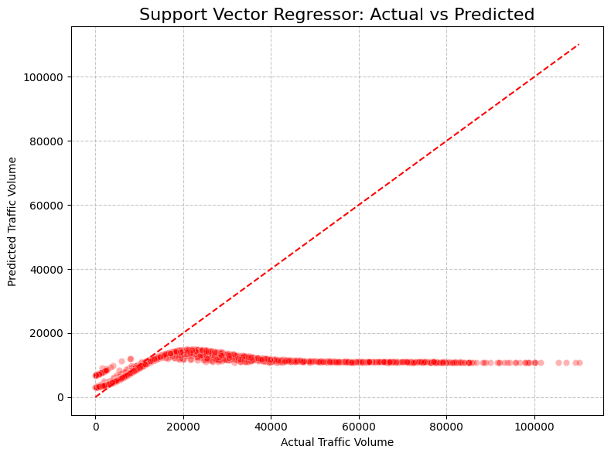
MODEL INITIAL EVALUATION

Slide 27
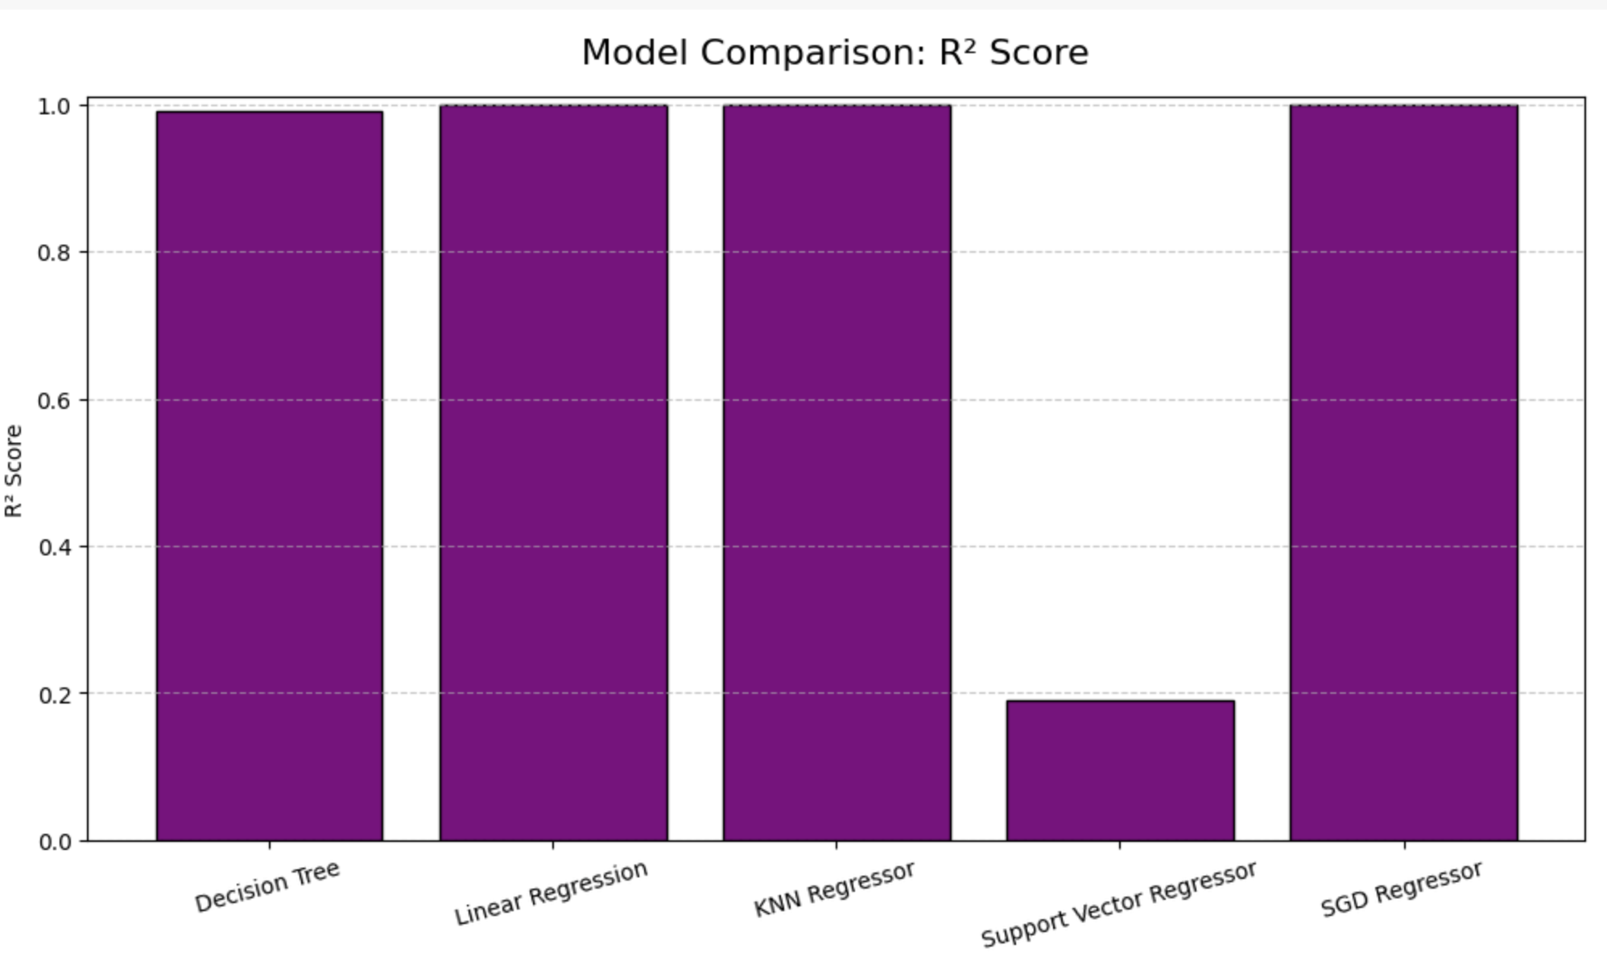
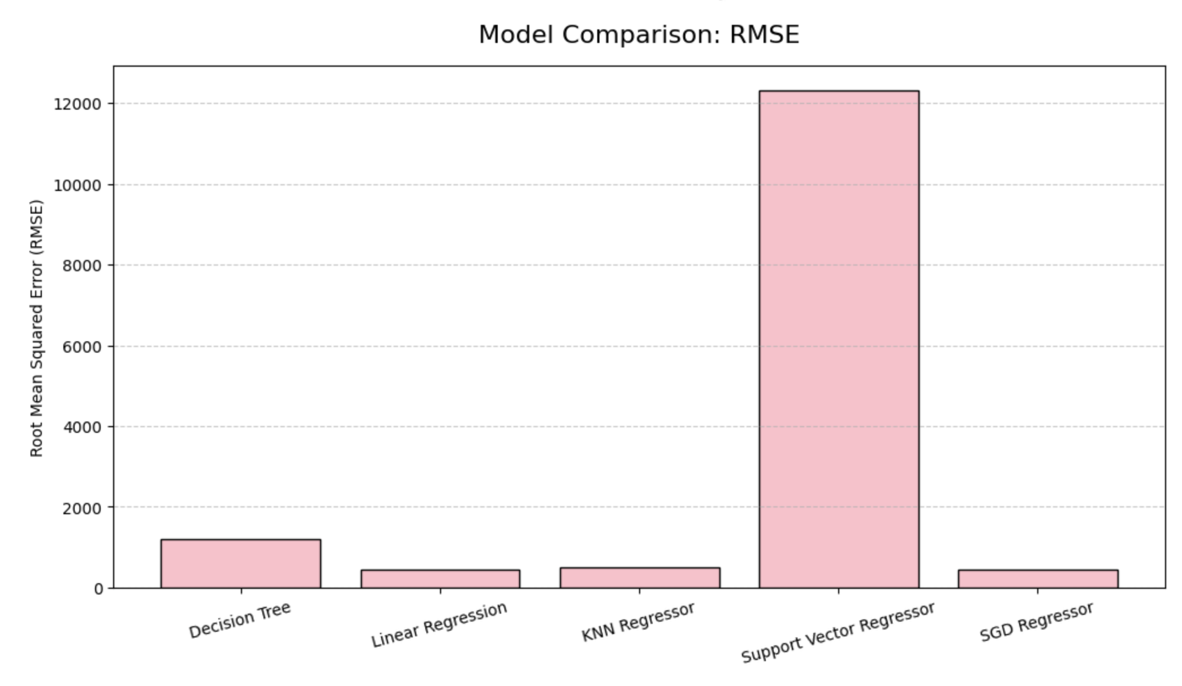
MODEL INITIAL EVALUATION

Slide 28
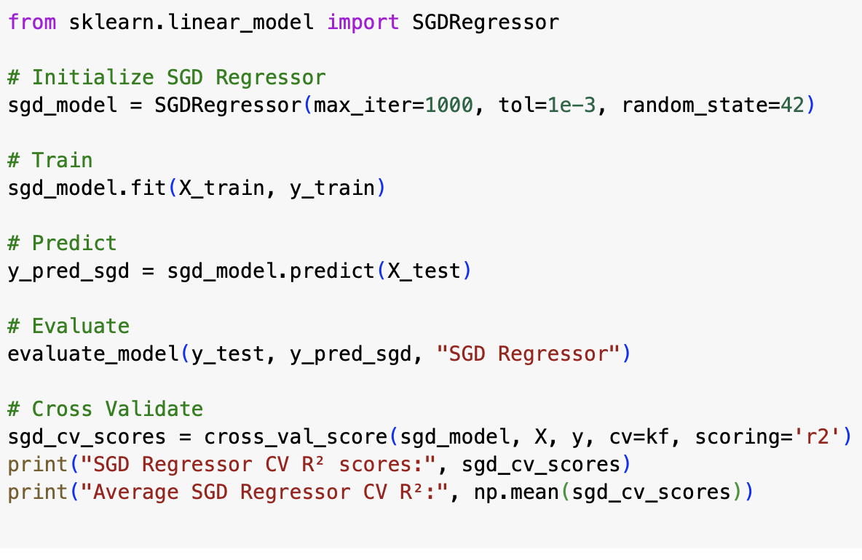
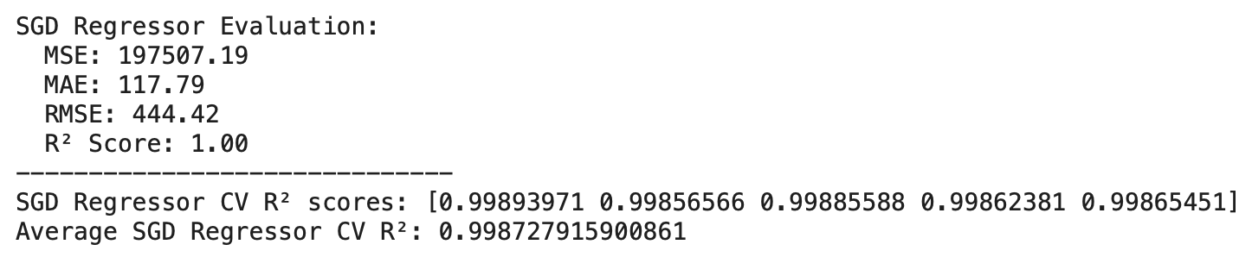
OPTIMISER (SGD REGRESSOR)
Used SGD Regressor to apply stochastic gradient descent for optimizing model parameters and minimizing prediction errors.
Standardized features to ensure stable convergence.

Slide 29
HYPERPARAMETER TUNING
Models Tuned:
Decision Tree Regressor:
Tuned max_depth, min_samples_leaf, min_samples_split (using GridSearchCV)
K-Nearest Neighbors (KNN) Regressor:
Tuned n_neighbors, weights (using GridSearchCV)
SGD Regressor:
Adjusted max_iter manually for convergence
Tuning Method:
GridSearchCV used to find best hyperparameters systematically.
5-Fold Cross-Validation was applied during tuning.

Slide 30
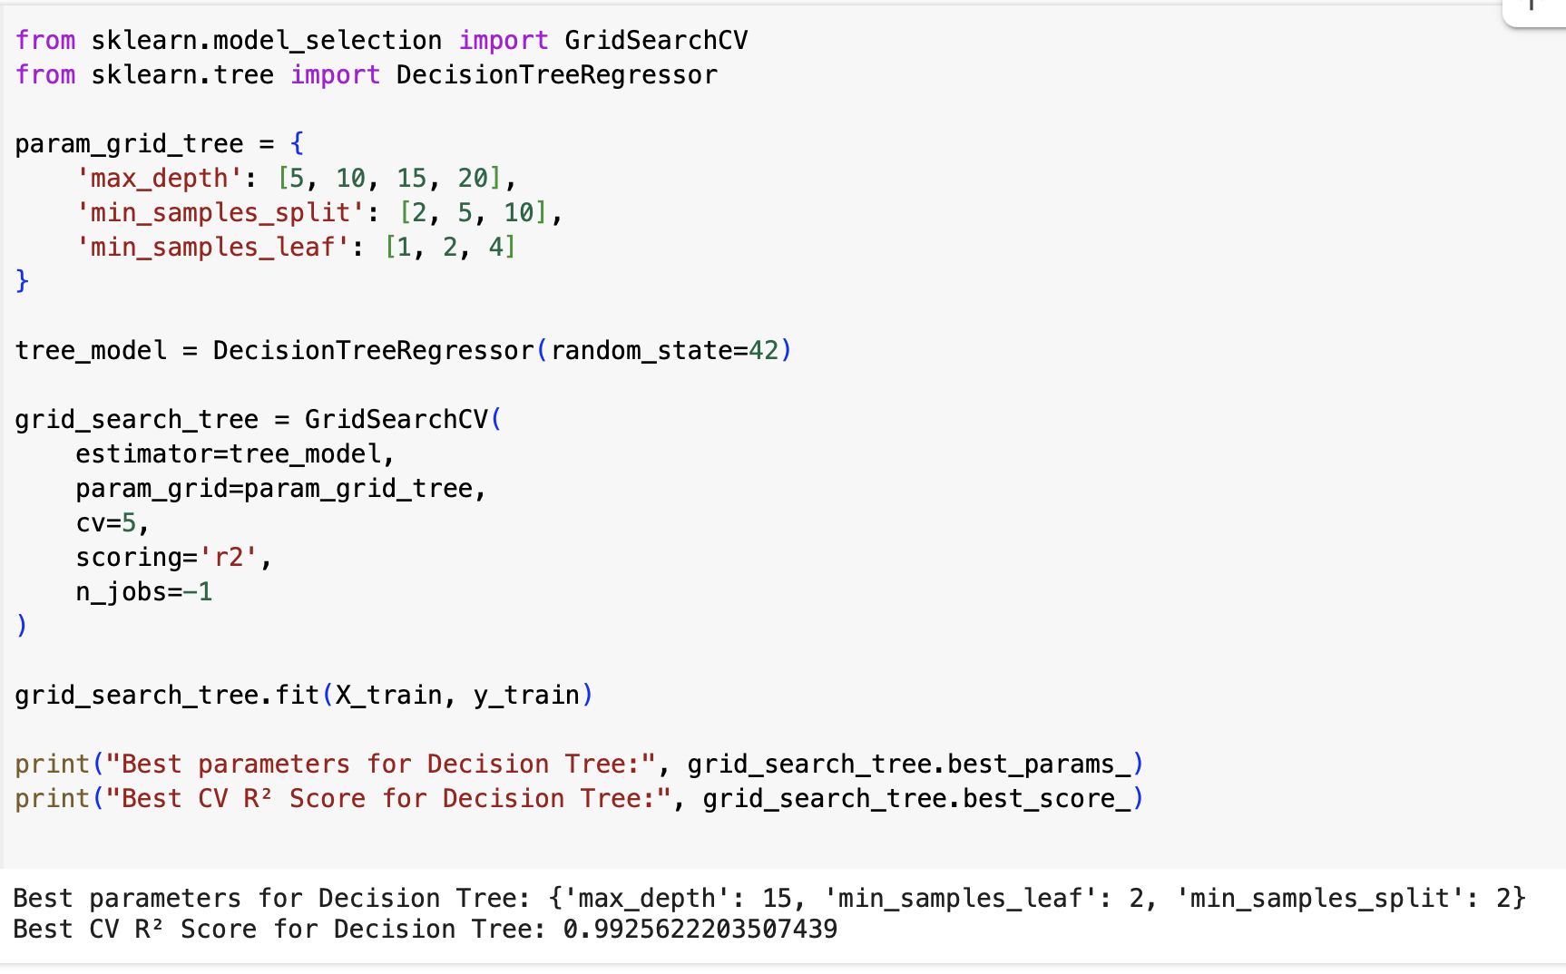
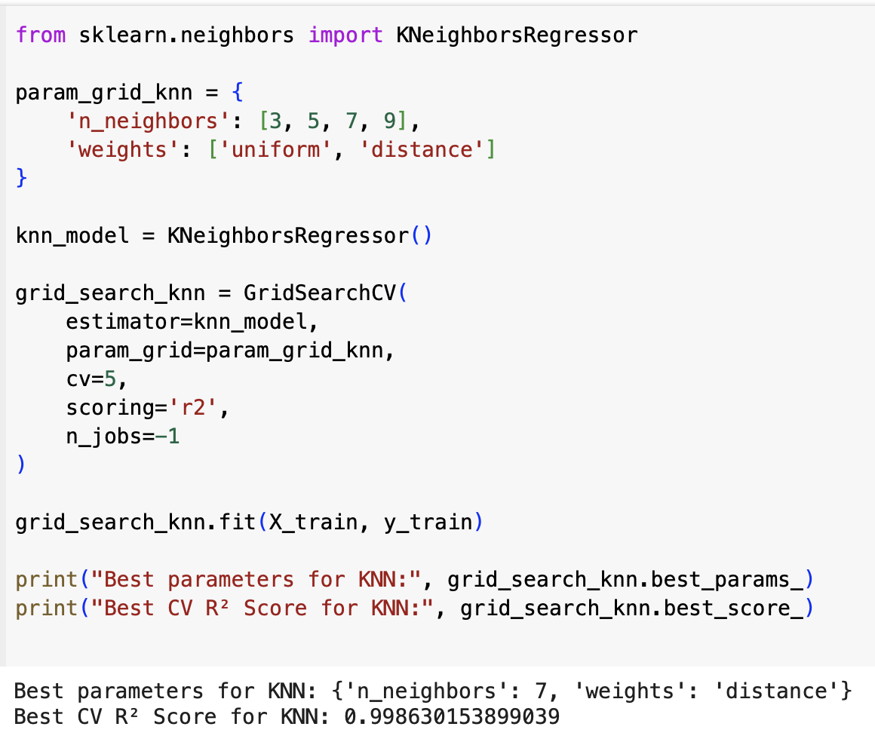
HYPERPARAMETER TUNING

Slide 31
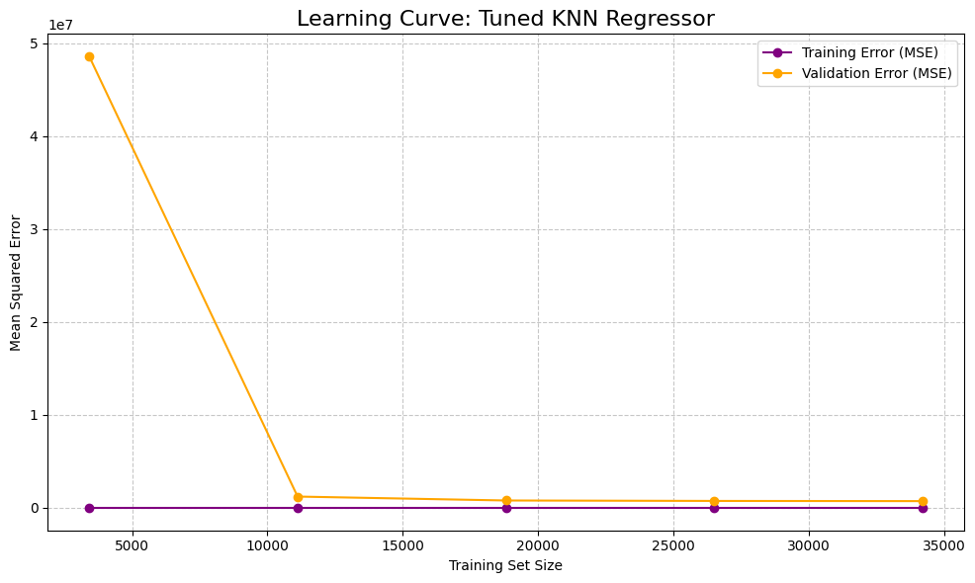
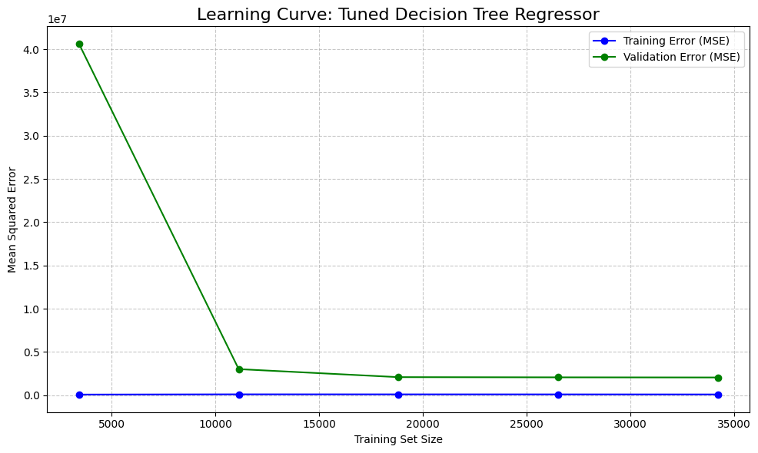
HYPERPARAMETER TUNING

Slide 32
HYPERPARAMETER TUNING
Why These Hyperparameters Were Tuned:
Decision Tree:
max_depth: Controls model complexity and prevents overfitting.
min_samples_leaf: Smooths tree by requiring minimum samples at leaves.
KNN Regressor:
n_neighbors: Balances bias and variance in predictions.
weights: Gives more influence to closer neighbors for better accuracy.
Why Only These Models:
Tree and KNN are sensitive to hyperparameters, tuning improves them significantly.
Linear Regression has no tunable hyperparameters.
SVR showed poor performance; tuning was not prioritized.

Slide 33
MODEL EVALUATION AND COMPARISON
Evaluation Metrics:
Evaluated all models using MSE, MAE, RMSE, and R².
Best models: Linear Regression, SGD Regressor, and Tuned KNN (highest R², lowest RMSE).
Decision Tree performed slightly lower, but still strong.
SVR performed poorly (low R², very high RMSE).

Slide 34
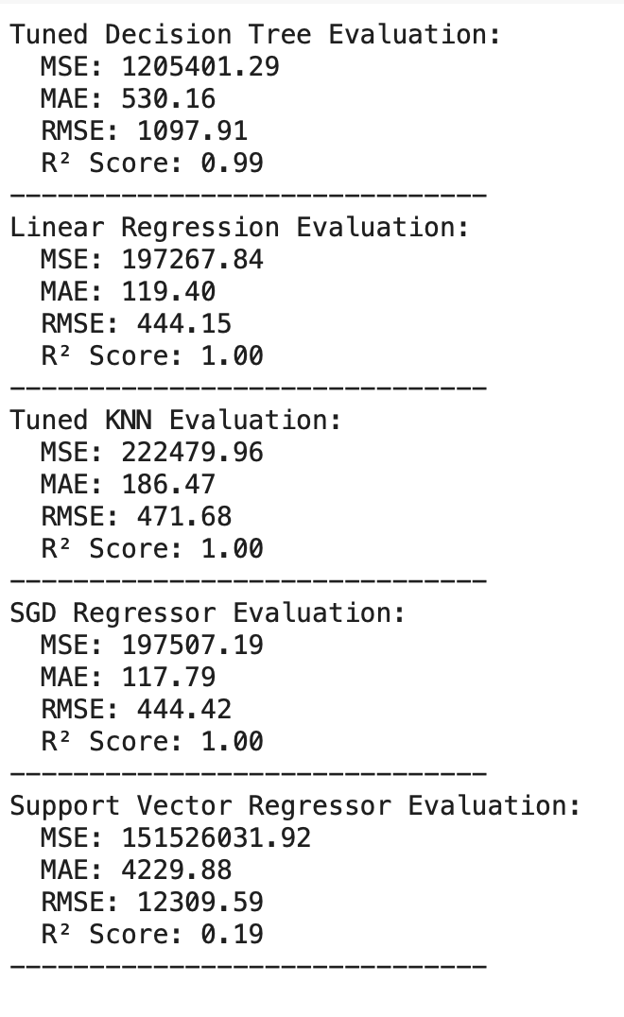
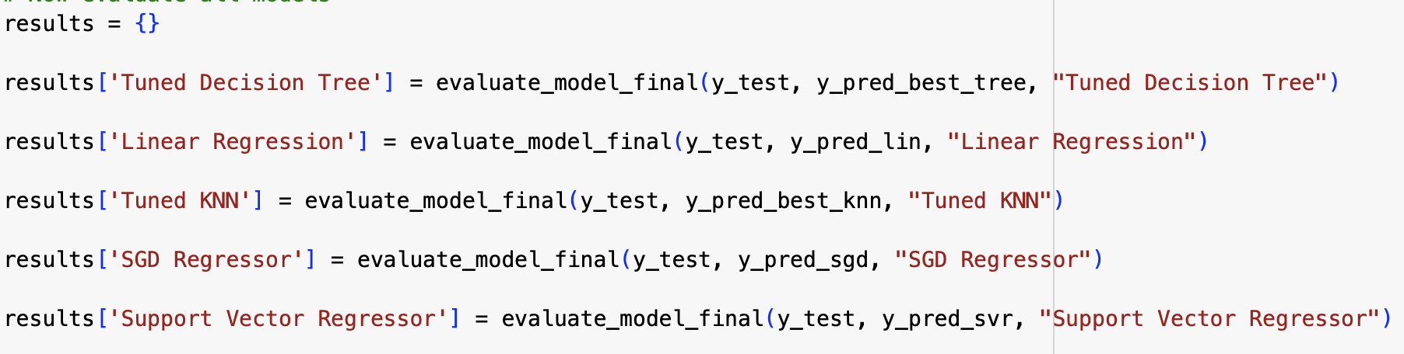
MODEL EVALUATION AND COMPARISON
Linear Regression and SGD Regressor selected as best models for traffic volume prediction.

Slide 35
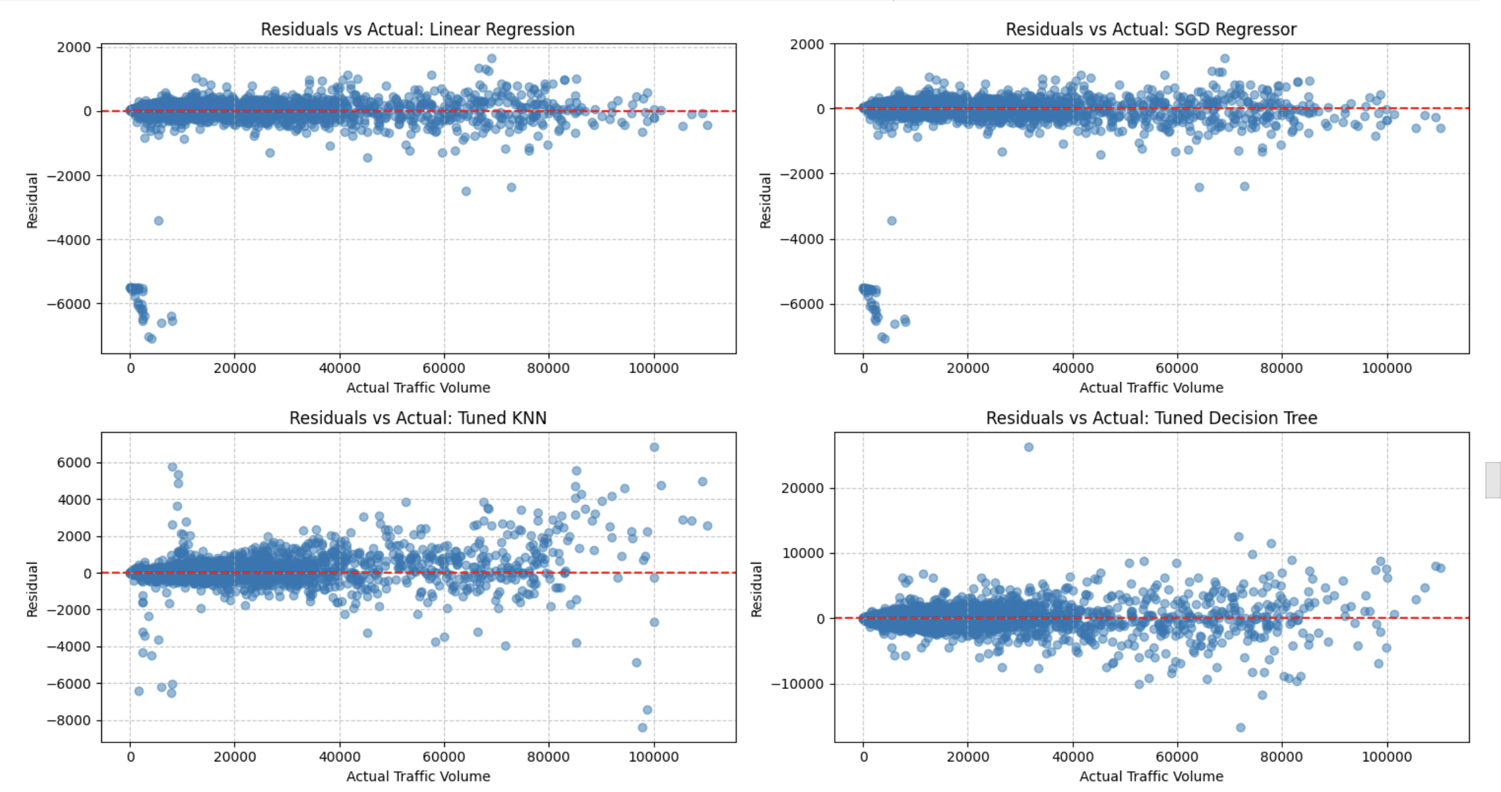
MODEL EVALUATION AND COMPARISON

Slide 36
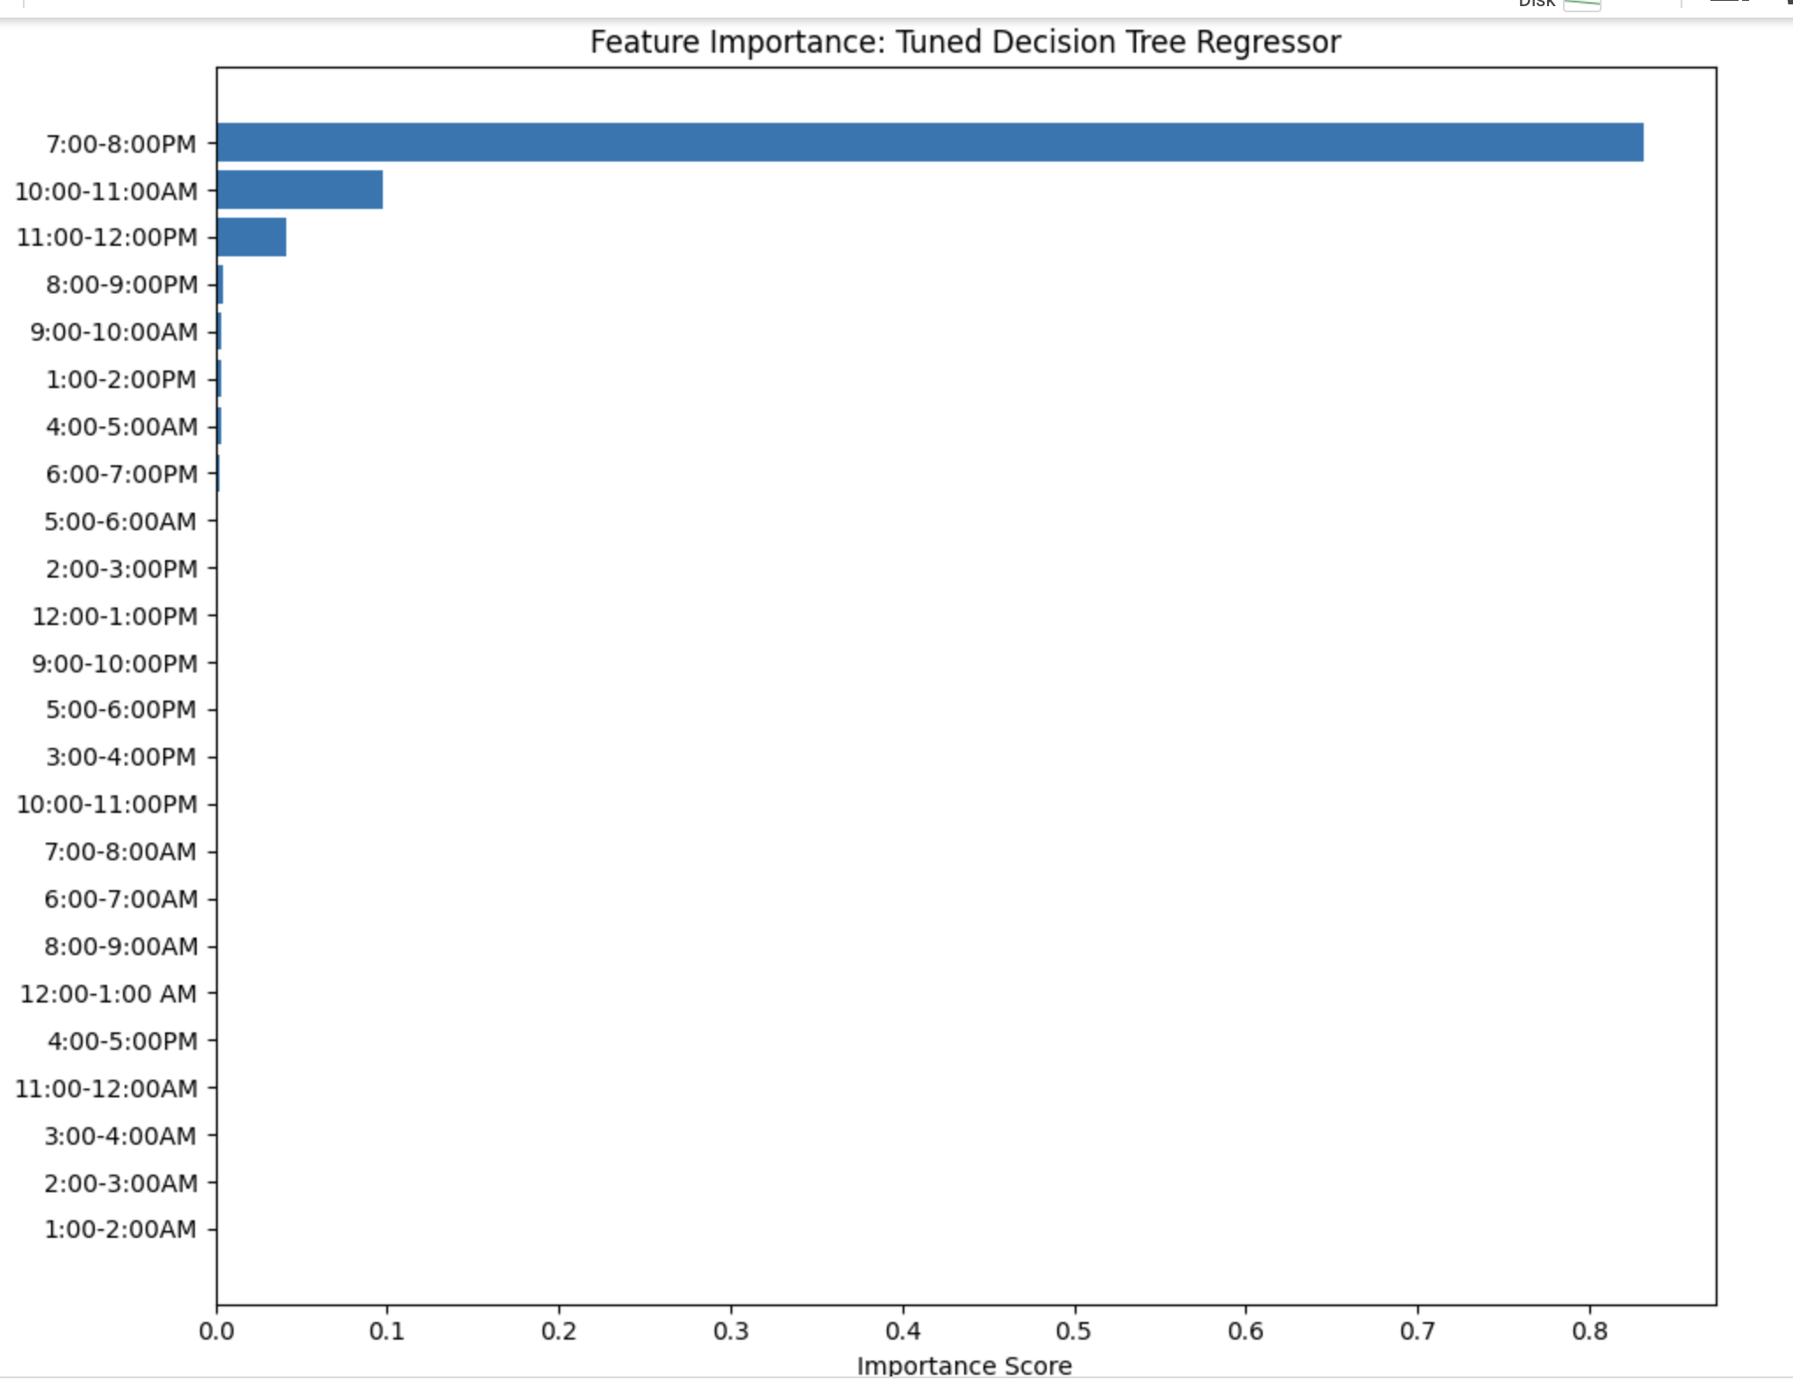
MODEL EVALUATION AND COMPARISON

Slide 37
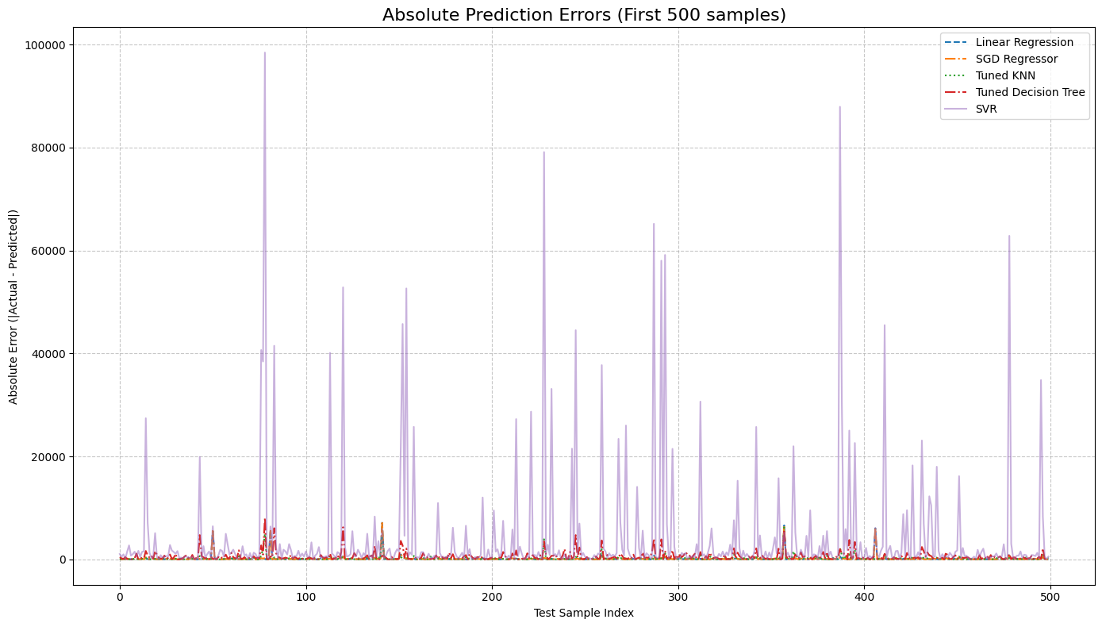
MODEL EVALUATION AND COMPARISON

Slide 38
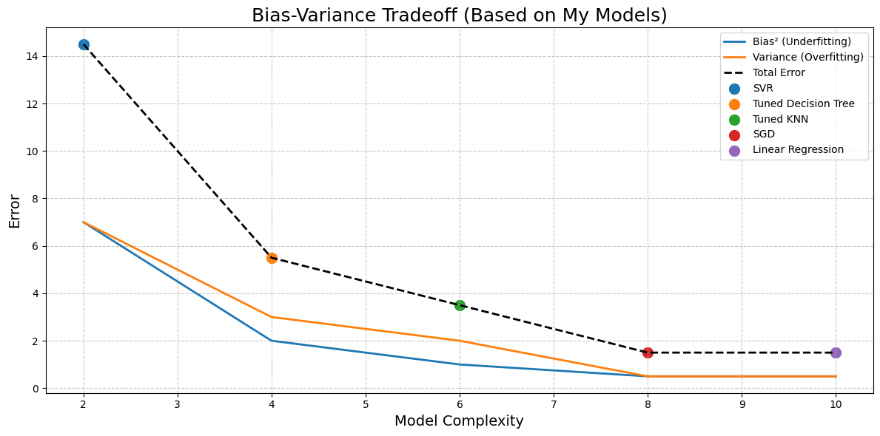
MODEL EVALUATION AND COMPARISON

Slide 39
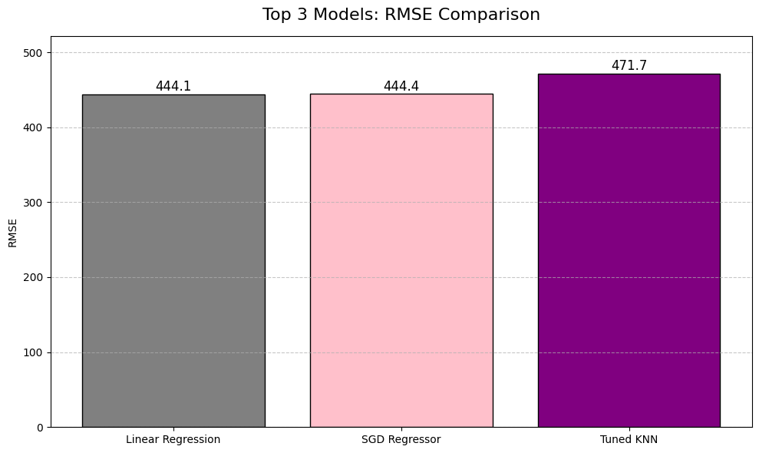
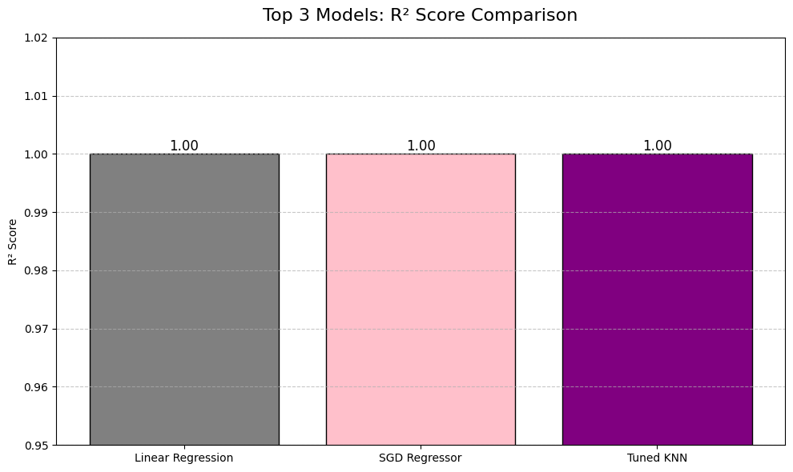
MODEL EVALUATION AND COMPARISON

Slide 40
KEY TAKEAWAYS
Final Insights:
Linear Regression and SGD Regressor delivered the best prediction performance with lowest RMSE and highest R² (≈ 1.00).
Tuned KNN also performed very closely, slightly behind Linear and SGD.
Decision Tree showed strong performance after tuning but slightly higher error compared to Linear/SGD.
SVR performed poorly with high errors and low R², not suitable for this dataset.
Hyperparameter tuning significantly improved Decision Tree and KNN models.

Slide 41
CONCLUSION
Predicting traffic volume using regression models is highly feasible with well-chosen features and preprocessing.
Feature scaling and optimization (SGD) played critical roles in model performance.
Hyperparameter tuning helped improve model generalization and avoid overfitting.
Linear Regression is recommended as the best model for traffic volume prediction in this project due to its simplicity, accuracy, and generalization.

Slide 42

Jayashree Johnson
Presented By:

